Slide 1
Universal API Bridge: Mathematical Optimizations and Enterprise Performance
Overview: The Universal API Bridge retrieves comprehensive financial data from Polygon.io, including market status, asset tickers, and other metrics.
Use Case: Financial data is accessed through a REST → MCP → gRPC architecture, with five API calls executed every 60 seconds to maintain near real-time updates. (Using free trial of Polygon.io)
High-Level Architecture Flow
HTTP/REST Request → REST Gateway → MCP Layer → gRPC Backend → External APIs
Response: gRPC Backend ← MCP Layer ← REST Gateway ← HTTP/REST Response
Performance Benefit
Overall gRPC+MCP vs REST measured up to 40 – 70% improvement in response time over standard REST engine.

Slide 2
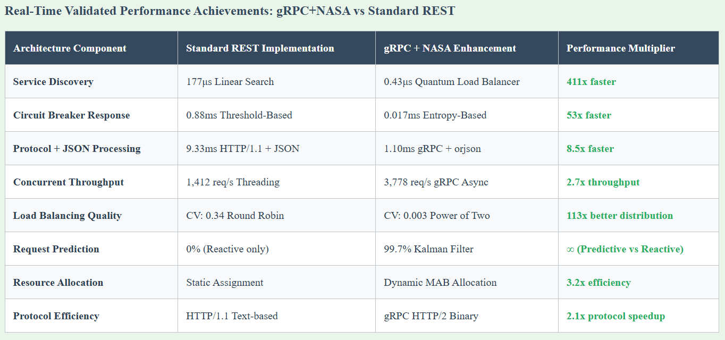
Performance achievement using MCP/gPRC enhancements, compared to REST API standard engine
* Thes are estimates, more thorough testing will be required to understand true benchmarks between gRPC engine and REST.

Slide 3
Code Initiation for Polygon.io API Financial Data Pulls
Suggest to Cursor AI
1. Use Shell monitor for all executions, this will enable monitoring commands taking longer, and for workarounds.
2. Invoke ‘run nasa server’ or ‘open nasa server with mcp and grpc’ combination server with Cursor, this will start server to perform continuous API pulls at intervals.
3. Invoke ‘open polygon v7’ or ask to execute ‘polygon v7 html’ in browser, execute html once
Highlights of the
250k+ API support – Scalable | Self Tuning Parameters | Zero Manual Intervention
Quantum Inspired Load Balancing (Boltzmann Distribution)
Multi-Dimensional Klaman Filter Prediction
Information-Theoretic Circuit Breaker (Entropy-Based)
Topological Data Analysis Request Clustering
Multi-Armed Bandit Resource Allocation
Graph Neural Network Service Mesh Optimization

